Slide 1
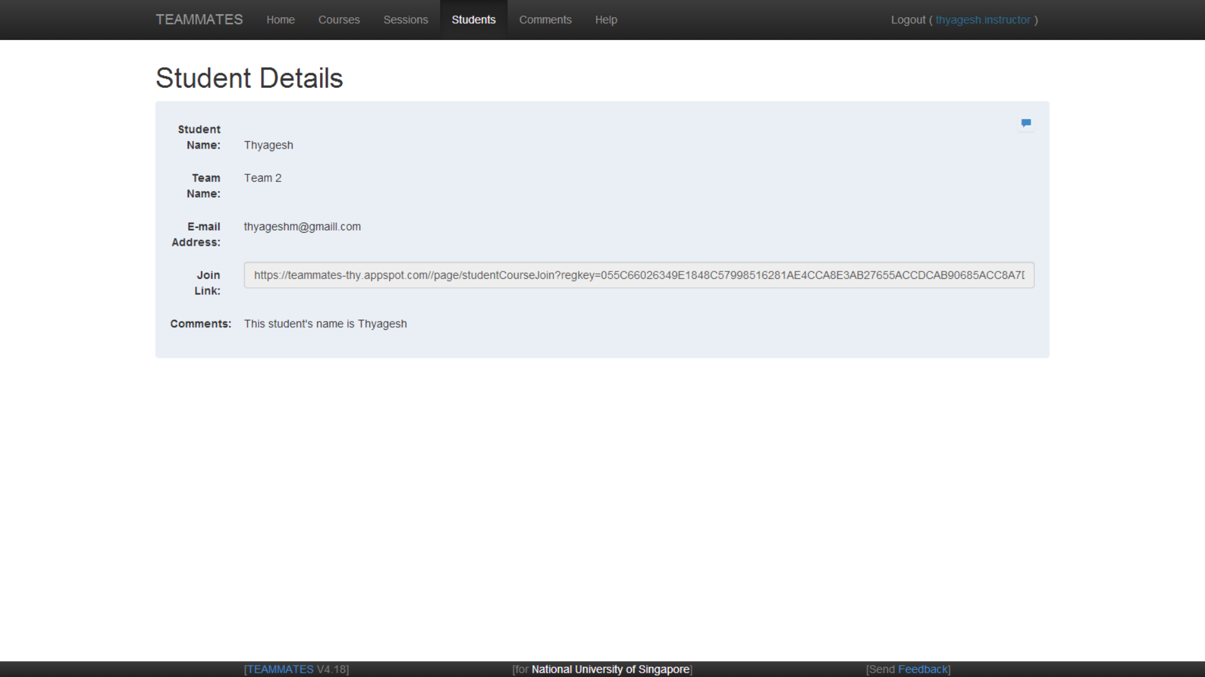
Before Profile was added

Slide 2
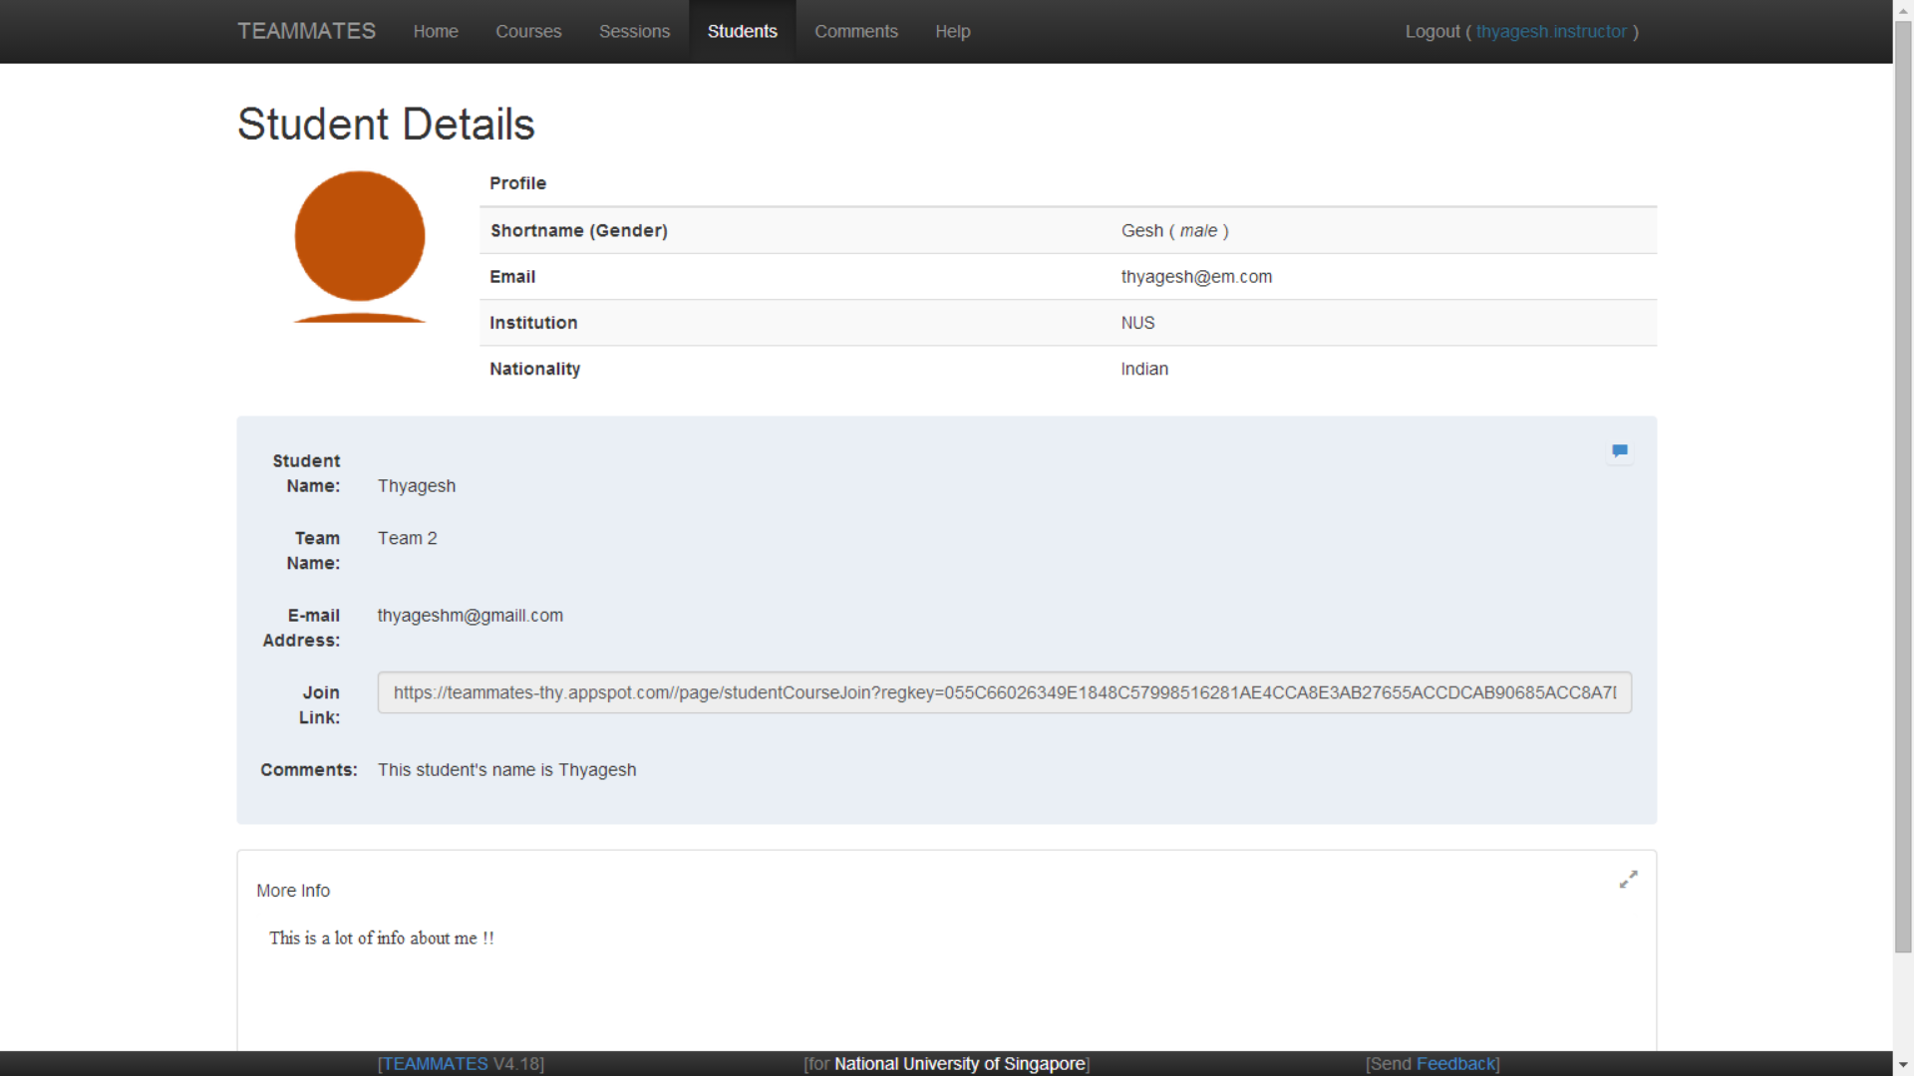
After Profile was added - 1

Slide 3
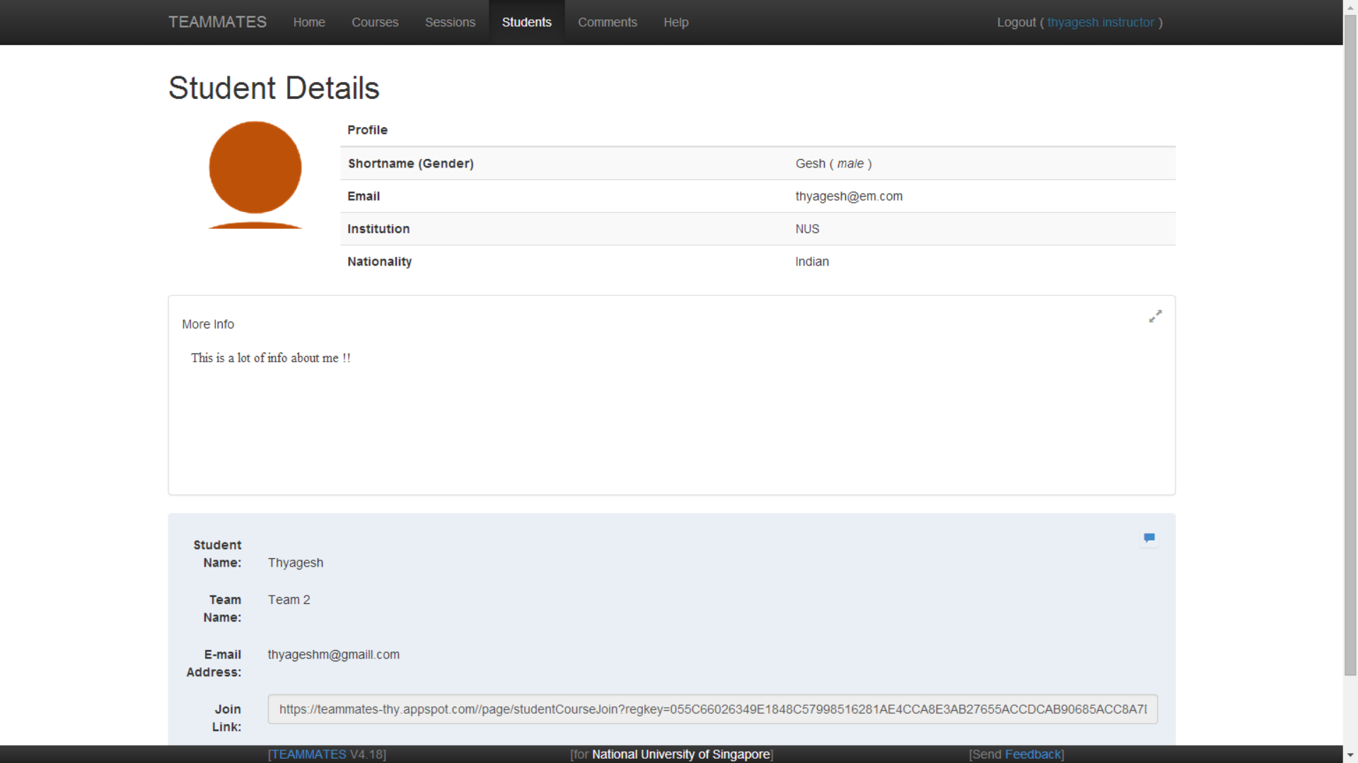
After Profile was added - 2

